Slide 1
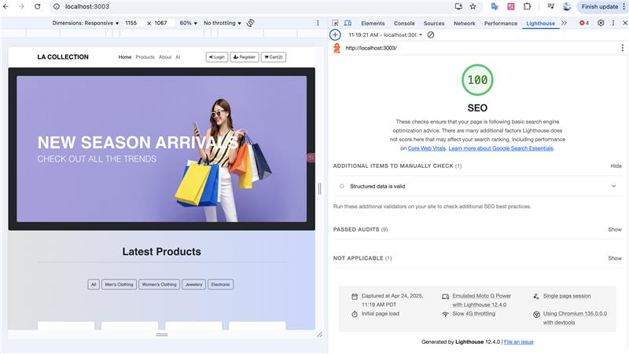
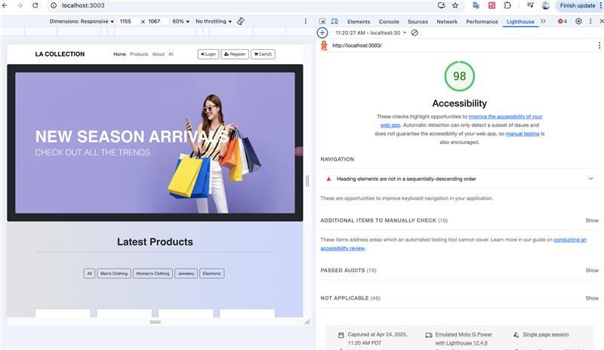

Slide 2
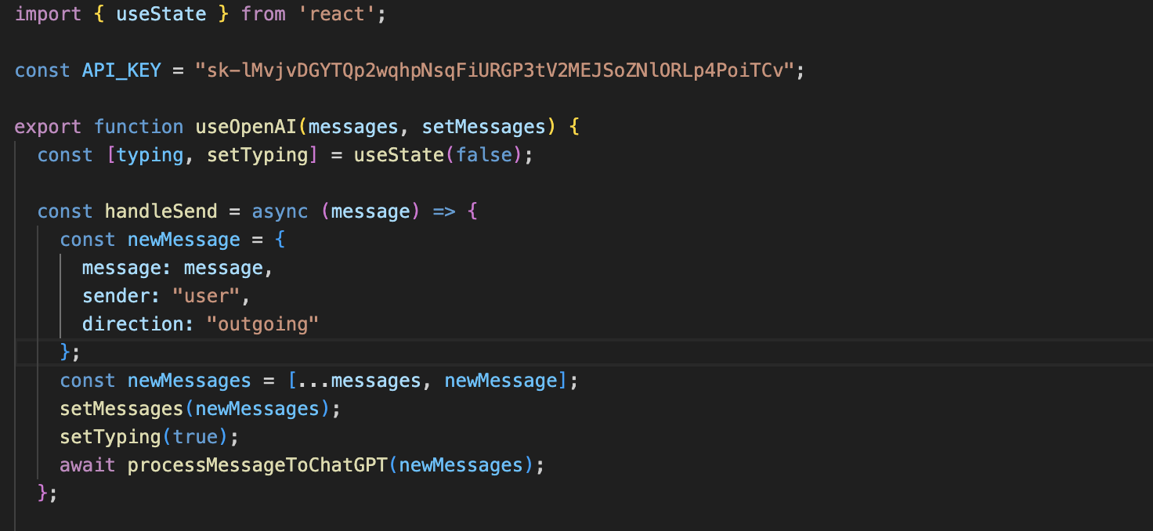

Slide 3
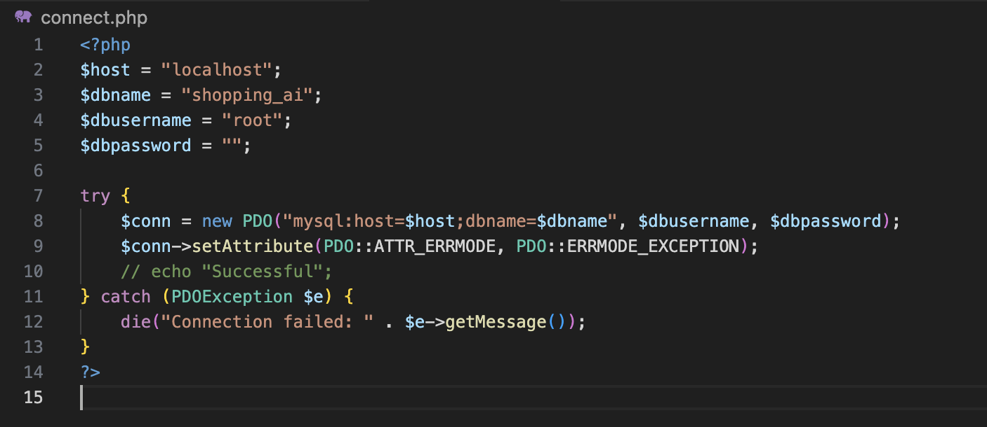
Connect SQL

Slide 4
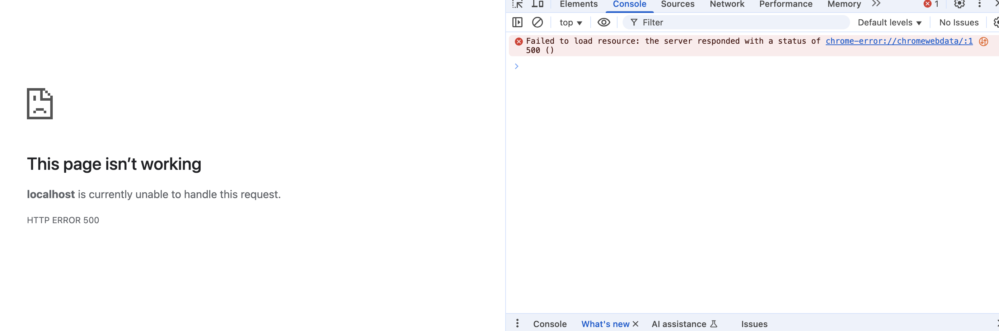
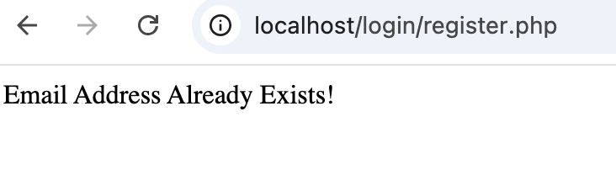
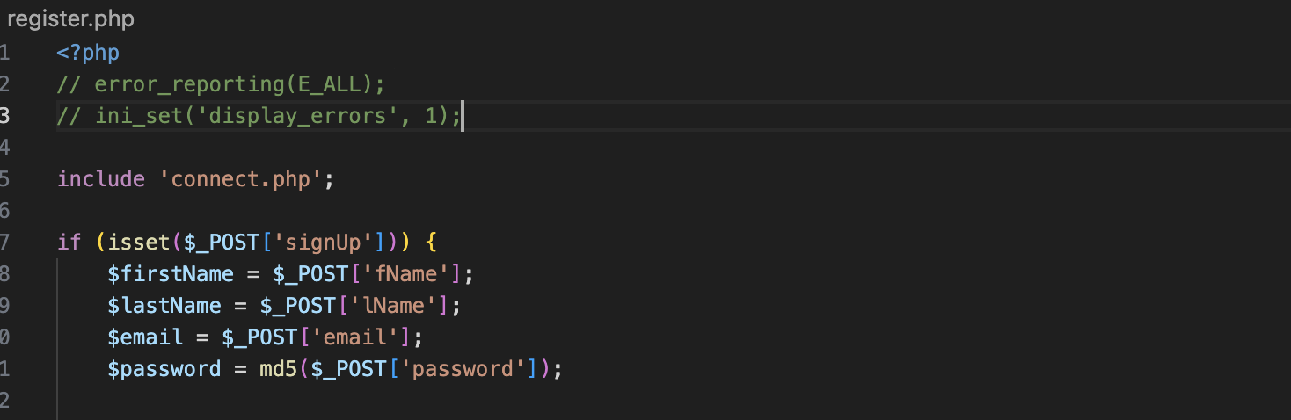
Debug
Fatal error: Uncaught PDOException: SQLSTATE[HY000]: General error: 1364 Field 'id' doesn't have a default value in /Applications/XAMPP/xamppfiles/htdocs/login/register.php:28 Stack trace: #0 /Applications/XAMPP/xamppfiles/htdocs/login/register.php(28): PDOStatement->execute() #1 {main} thrown in /Applications/XAMPP/xamppfiles/htdocs/login/register.php on line 28
ALTER TABLE users MODIFY COLUMN id INT NOT NULL AUTO_INCREMENT;

Slide 5
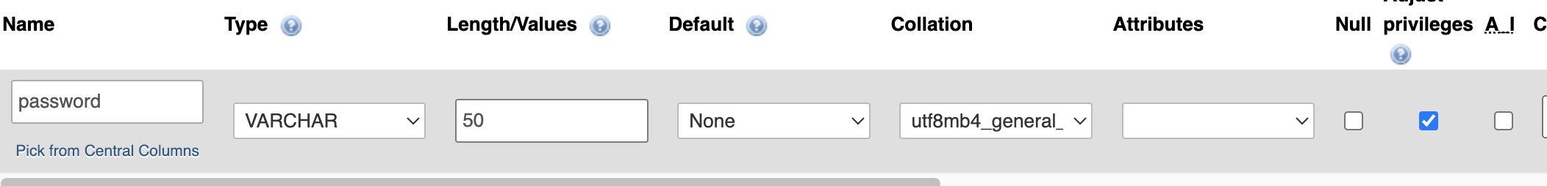
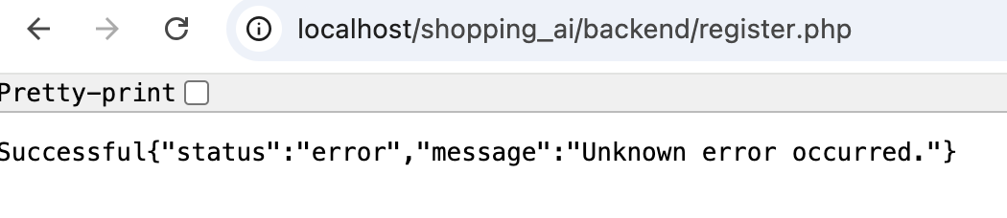
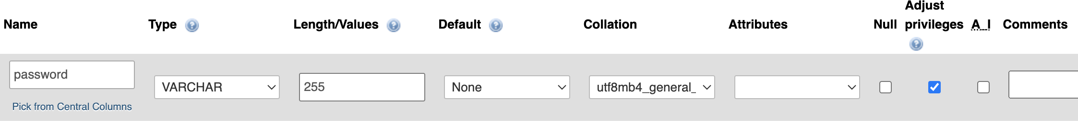
Successful<br /> <b>Fatal error</b>: Uncaught PDOException: SQLSTATE[22001]: String data, right truncated: 1406 Data too long for column 'password' at row 1 in /Applications/XAMPP/xamppfiles/htdocs/shopping_ai/backend/register.php:43 Stack trace: #0 /Applications/XAMPP/xamppfiles/htdocs/shopping_ai/backend/register.php(43): PDOStatement-&gt;execute() #1 {main} thrown in <b>/Applications/XAMPP/xamppfiles/htdocs/shopping_ai/backend/register.php</b> on line <b>43</b><br />
使用了 password_hash() 函数，它会生成一个 很长的加密字符串（默认 60 字符）。
但你数据库中 users 表里的 password 字段，长度不够存储它！
ALTER TABLE users MODIFY password VARCHAR(255);

Slide 6
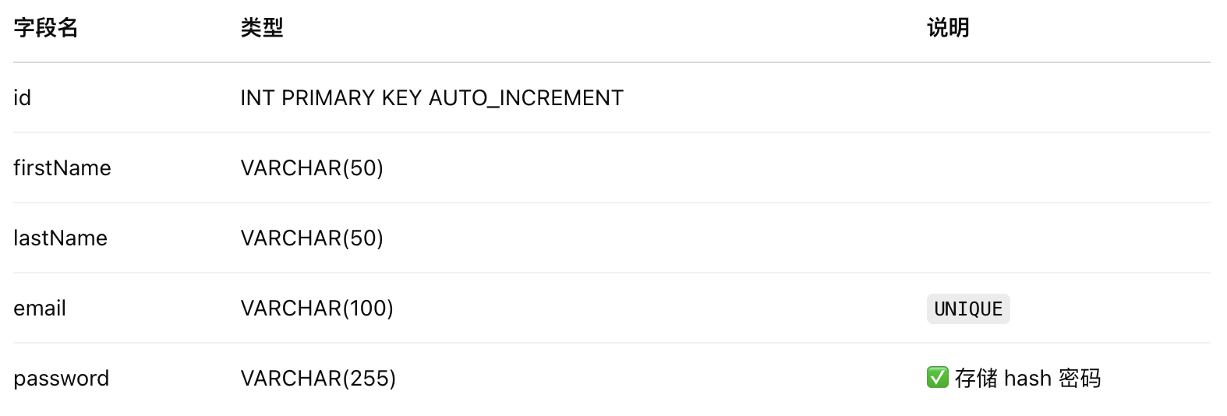

Slide 7
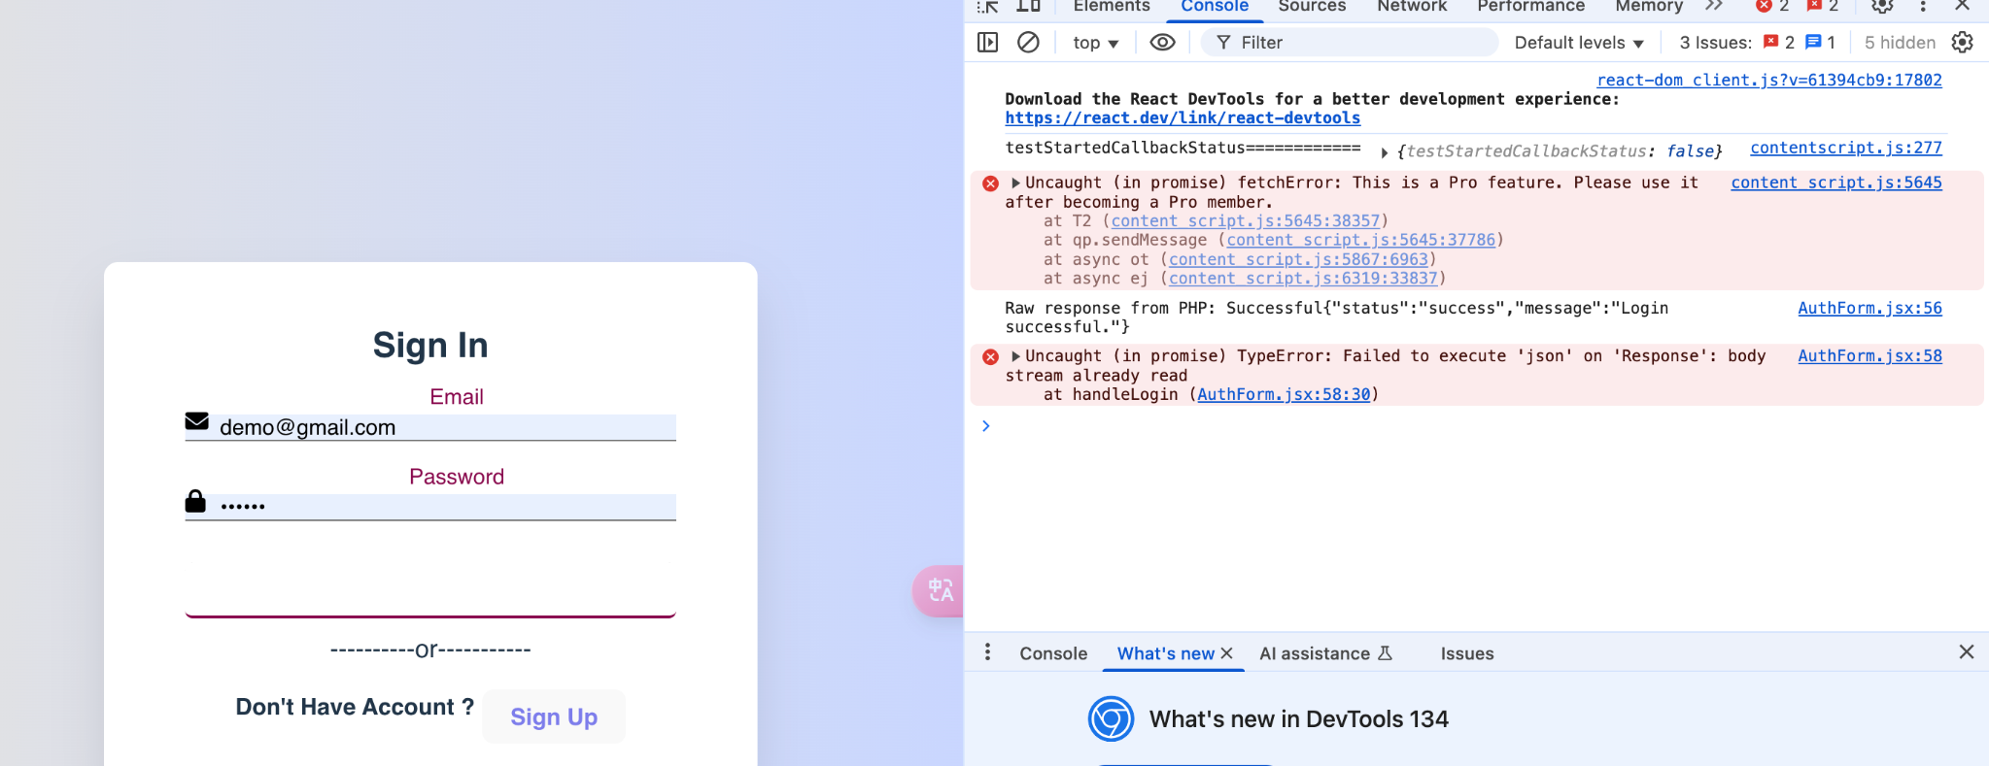
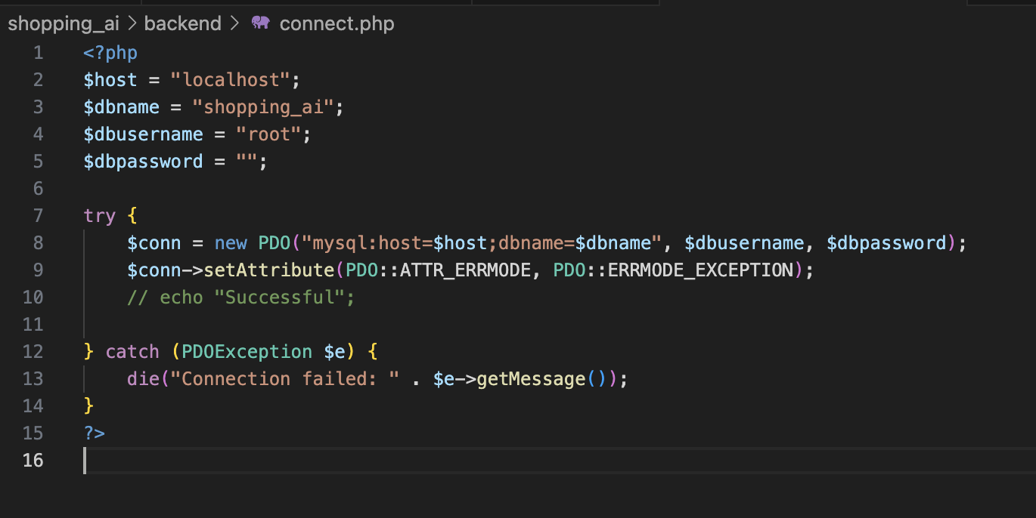

Slide 8
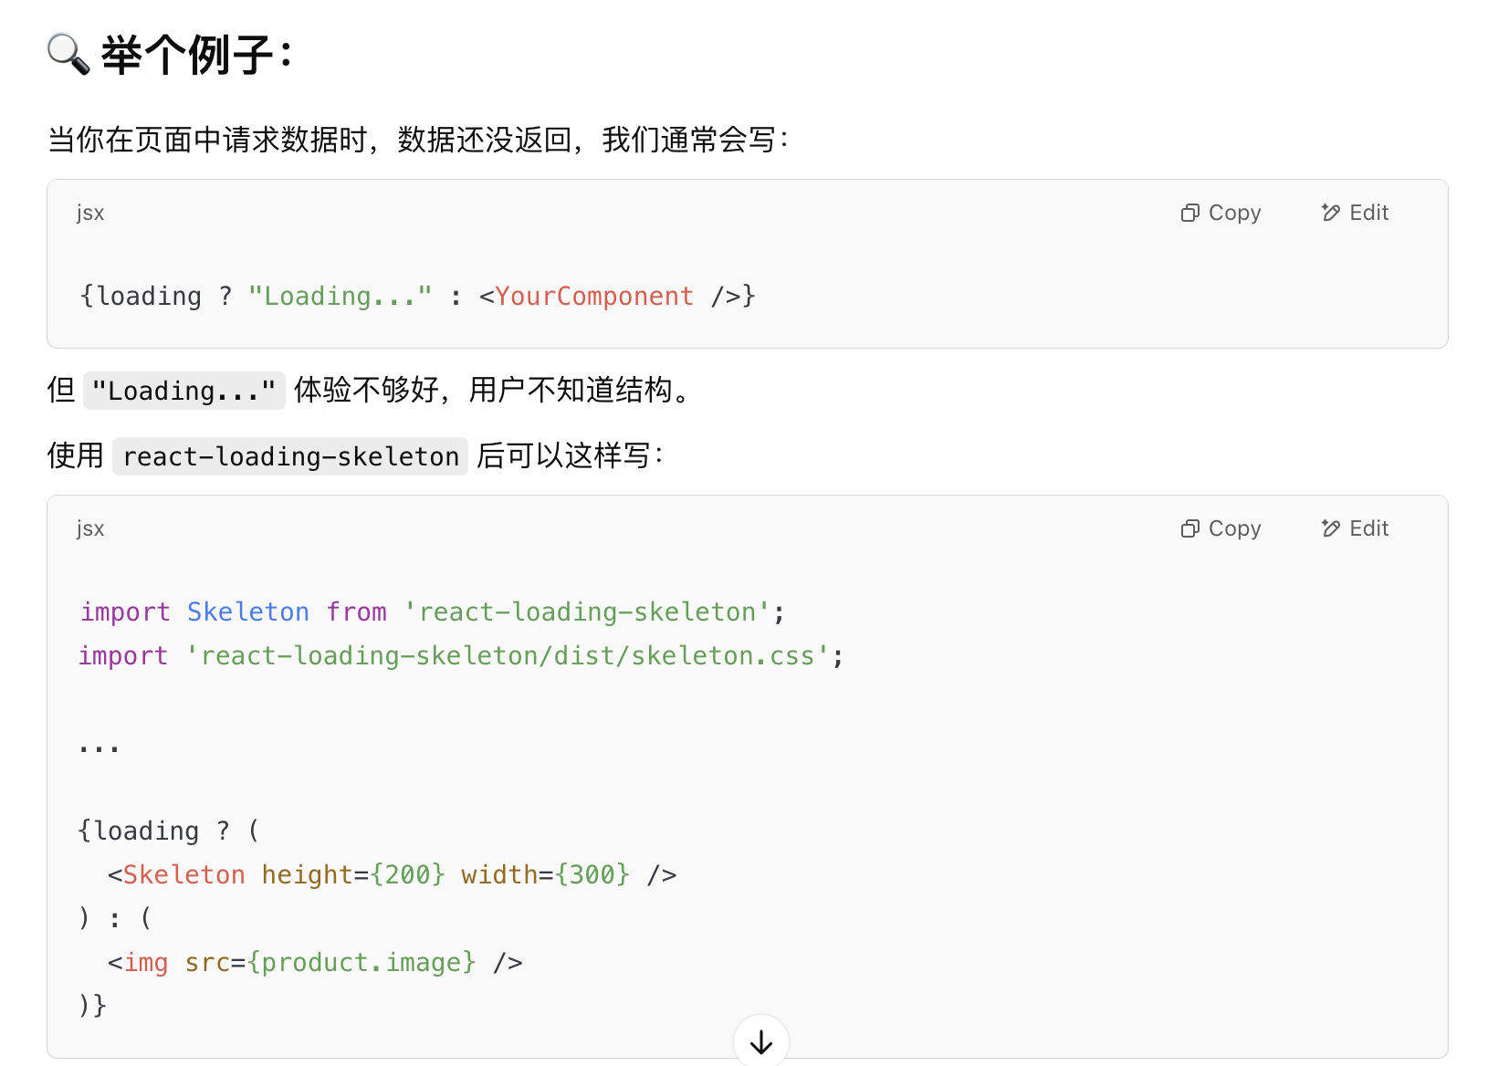
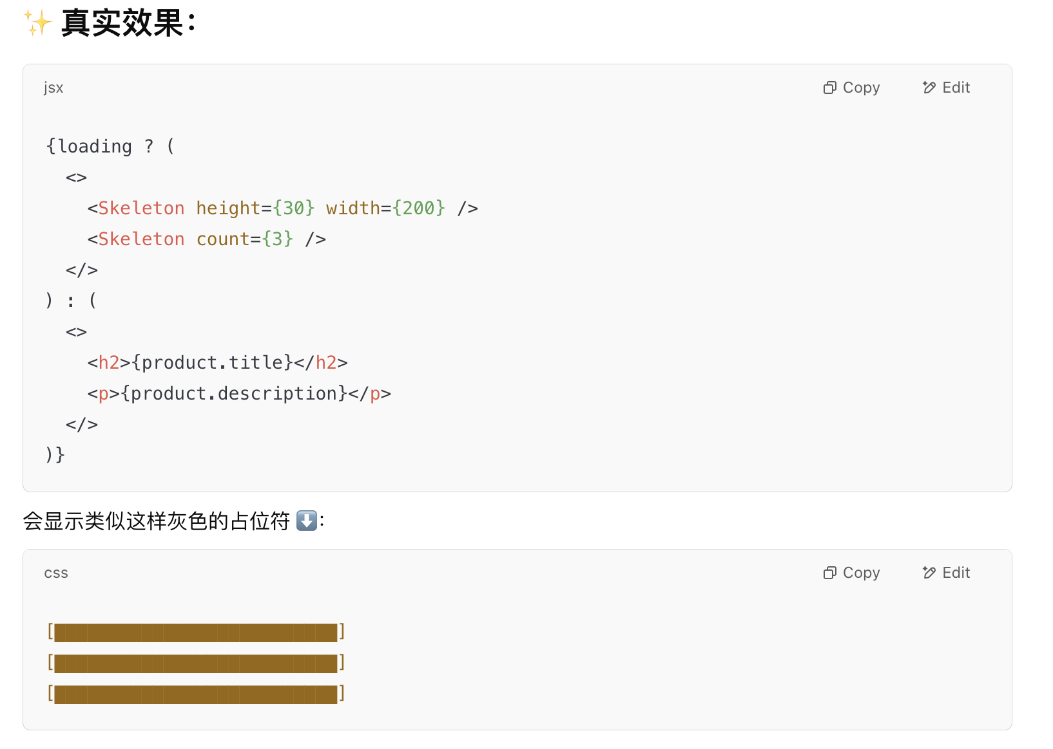
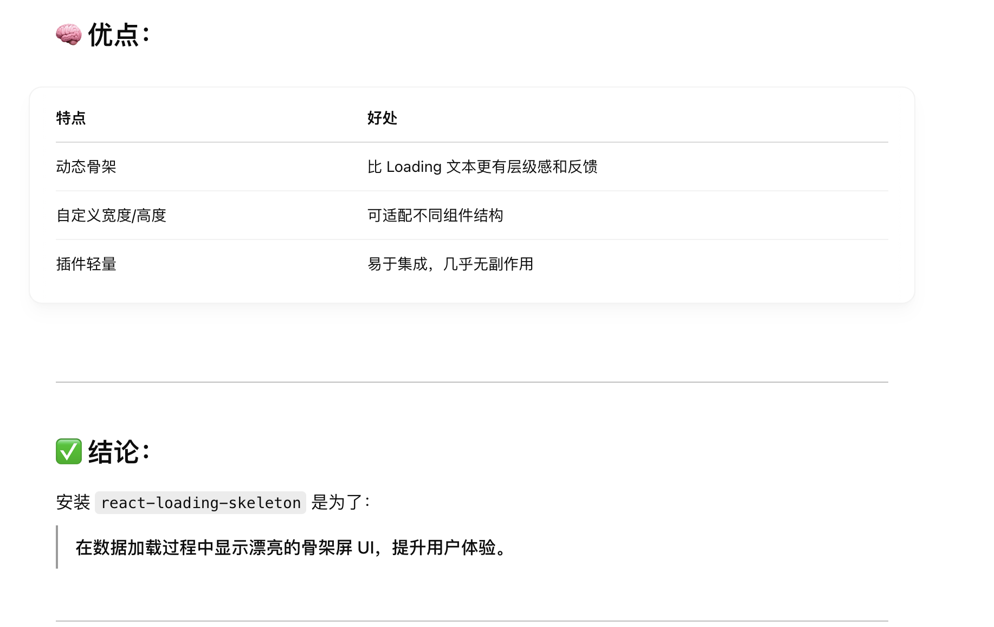
npm i react-loading-skeleton
const Loading = () => {
return (
<>
Loading...
</>
)
}

